Slide 1
noSQL & mongoDB

Slide 2
noSQL
Not only SQL
Non-relational databases
Types: Key-Value, Document, Graph, Search, etc.

Slide 3
History of noSQL
Created for the Internet (late 1990s, early 2000s) to handle:
Huge amounts of data
Very different data structures
Value flexibility & availability over immediate consistency
Distributed data

Slide 4
Storing a book
{
"title": "Spass mit Datenbanken",
"author": "Stefan Stanzel",
"publisher": "Springer Science + Business Media",
"isbn": "978-3-16-148410-0"
}

Slide 5
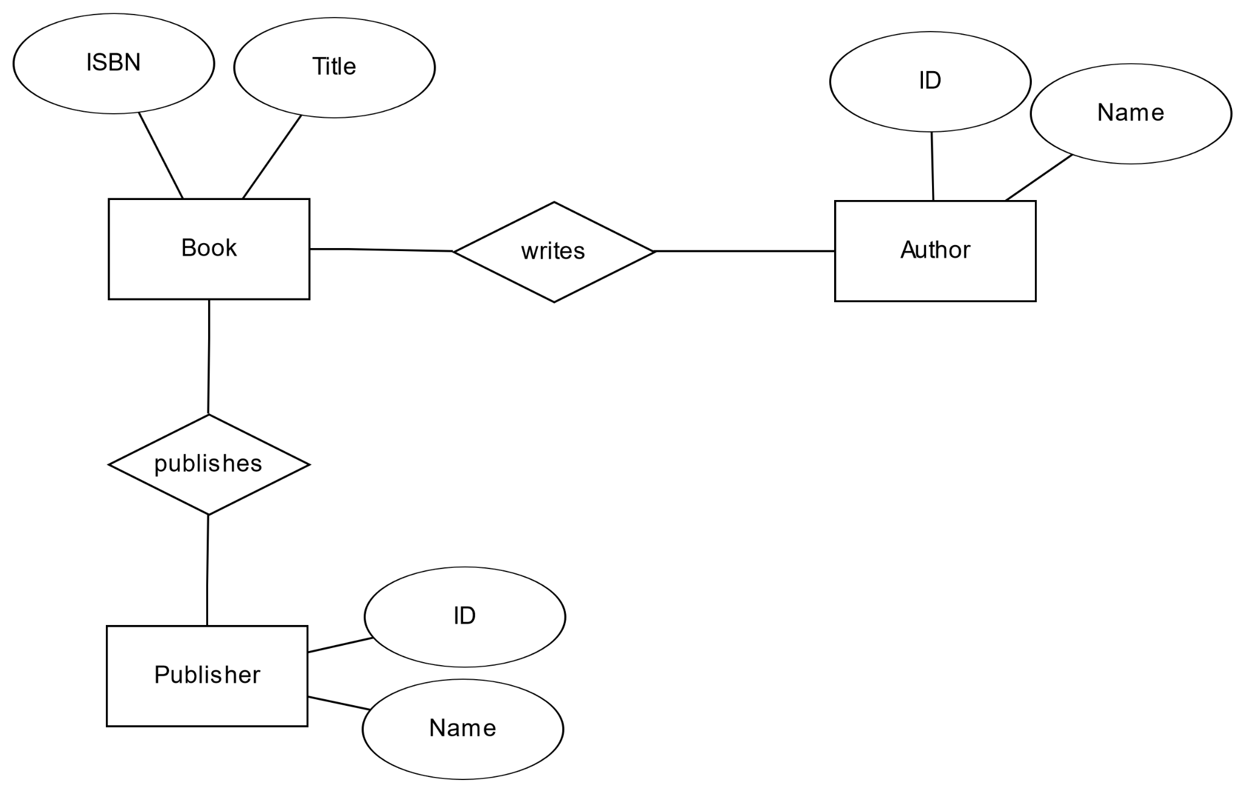
Book, relational

Slide 6
Book, mongoDB
{
_id: ObjectId("610c4d3b4d3b4b8bc7f718b27af8"),
title: 'Spass mit Datenbanken',
author: 'Stefan Stanzel',
publisher: 'Springer Science + Business Media',
isbn: '978-3-16-148410-0'
}

Slide 7
Relational vs. noSQL
Relational DBMS
Structured, well known data
Strict schema
Hard to modify
noSQL DBMS
Chaotic, unstructured data
Unknown data
No or flexible schema
Easy to modify
Notes:
ACID vs BASE?, unstructured data hard to fit into neat tables, vertical vs horizontal scaling

Slide 8
mongoDB
Document store (document - oriented DBMS)
Collections (≈tables)
Data stored like JSON objects (BSON)
Schema optional

Slide 9
mongoDB
Fast (good scaling)
Flexible
Eventual consistency
No normalization
Redundancy
Can’t use SQL
Notes:
Compare codds

Slide 10
final thoughts
Some simplifications!
Resources:
mongoDB university: https://university.mongodb.com/
mongoDB webshell: https://docs.mongodb.com/manual/tutorial/getting-started/

